Slide 1

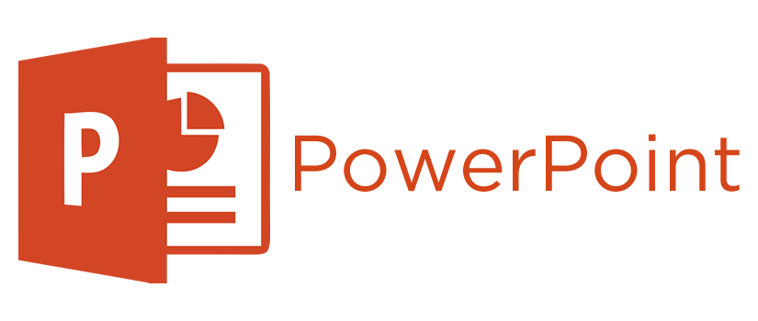




Home
*** Preview Release ***
Watch on
Multimodal Content
Read
Listen
Watch
What is Multimodal content?
What tools are available to create Multimodal content?
How can you manage and publish Multimodal content?
(my voice – manually recorded using the Narration feature in PowerPoint)
Notes:
This is a Preview Release of how Multimodal Slides can convert your PowerPoint content into multimodal content that one can read, listen, or watch. That multimodal content can then be published into your existing website or into a stand-alone website.
{CLICK}Since this is a Preview Release, there are some bugs to where various actions and performance aspects may not work as expected.
{CLICK}You can also watch the full animated experience on YouTube. The overall goal is to provide a similar experience within the web page as watching the video.
Here are some questions I will answer.
{CLICK}What is Multimodal content?
{CLICK}What tools are available to create Multimodal content?
{CLICK}How can you manage and publish Multimodal content?
{CLICK}If you are listening to this content, the lower left-hand corner of eacah slide will provide the source of the voice. This was done to demonstrate what is possible. For this slide, I simply manually recorded my voice using the Narration feature in PowerPoint. In later slides, I will use some various Text-To-Speech voices that are available with the Multimodal Slides Platform.

Slide 2
What is Multimodal Content?
Multimodal Content
Read
Listen
Watch
Multimodal content refers to information or communication that uses multiple modes or channels to convey a message or meaning.
These modes can include text, images, audio, video, and interactive elements.
The purpose of multimodal content is to enhance the user experience and make the information more engaging and accessible.
Text-to-Speech with Eric - a Male Voice
Notes:
What is Multimodal Content?
{CLICK}Multimodal content refers to information or communication that uses multiple modes or channels to convey a message or meaning.
{CLICK}These modes can include text, images, audio, video, and interactive elements.
{CLICK}The purpose of multimodal content is to enhance the user experience and make the information more engaging and accessible.

Slide 3
Multimodal Content Examples
Multimodal Content
Educational Videos
Read
Listen
Watch
Combining visual aids, spoken explanations, and text annotations to teach a concept.
Web Pages
Using a mix of text, images, videos, and interactive graphics to provide a rich user experience.
Presentations
Incorporating slides with text, images, and videos to support a verbal presentation.
Augmented Reality (AR) and Virtual Reality (VR)
Integrating audio, visual, and sometimes tactile elements to create immersive experiences.
Interactive Infographics
Combining data visualization, text, and interactive elements to present complex information clearly.
Text-to-Speech with Aria - a Female Voice
Notes:
Some Examples include…
{CLICK}Educational Videos: Combining visual aids, spoken explanations, and text annotations to teach a concept.
{CLICK}Web Pages: Using a mix of text, images, videos, and interactive graphics to provide a rich user experience.
{CLICK}Presentations: Incorporating slides with text, images, and videos to support a verbal presentation.
{CLICK}Augmented Reality (AR) and Virtual Reality (VR): Integrating audio, visual, and sometimes tactile elements to create immersive experiences.
{CLICK}Interactive Infographics: Combining data visualization, text, and interactive elements to present complex information clearly.
By leveraging multiple modes, content creators can cater to different learning styles and preferences, making the information more accessible and engaging.

Slide 4
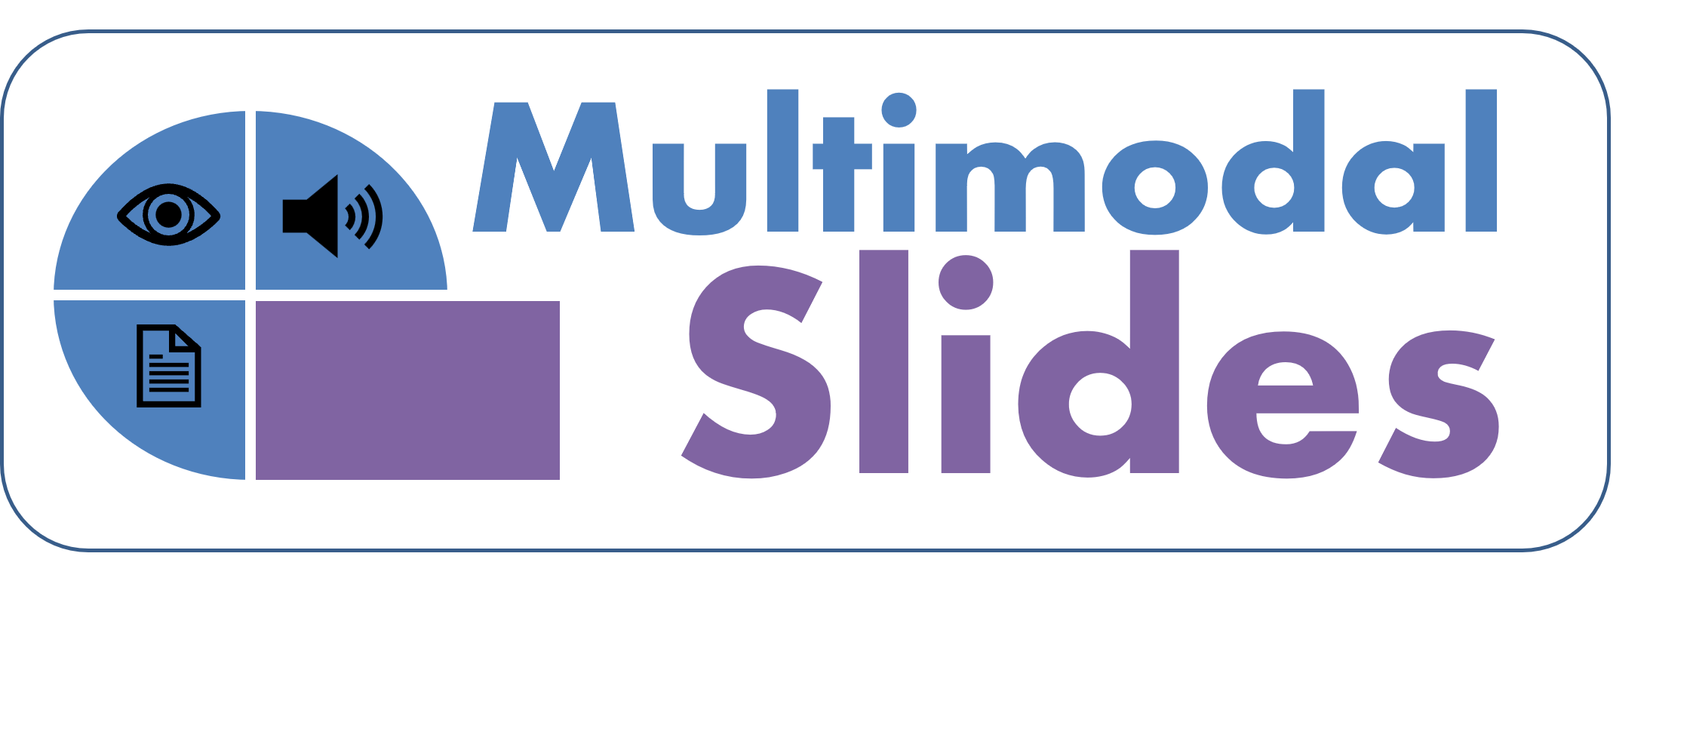
Why should you create Multimodal Content?
“The world is moving to a place where content needs to be in multiple forms because consumers are consuming content in multiple ways.”
Gary Vaynerchuk
Overwhelmed?
How many different tools do I need?
What is the effort involved?
Text-to-Speech with Roger - a Male Voice
Notes:
Why should you create Multimodal Content?
{CLICK}“The world is moving to a place where content needs to be in multiple forms because consumers are consuming content in multiple ways.” - said by Gary Vaynerchuk (also known as Gary V.)
{CLICK}Well, does this sound overwhelming?
{CLICK}It sounds like you need a lot of different tools, {CLICK}and a lot of effort, and maybe more people, to manage and publish content in multiple ways.
Overall, this sounds painful and not practical to manage.

Slide 5


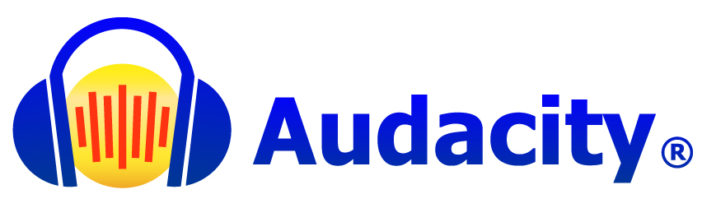

The Problem
This is why most of us do not create Multimodal content – it is Too Hard!
Create
Convert
Publish
Document/Diagram Editor
PDF / Images
Attach and Send Email
Web Page Editor
Blog Post
Blog Website
Markdown Editor
Documentation Article
Documentation Wiki
Video Editor
Video File (.mp4)
Video Platform
Audio Editor
Audio File (.mp3)
Podcast Platform
Slides Editor
Online Presentation
Slide Sharing Website
Too Many Editors
Too Many Outputs
Too Many Ways to Share
Text-to-Speech with Jenny - a Female Voice
Notes:
Let’s first acknowledge and break down this problem. Creating, converting, and publishing multimodal content {CLICK}requires a lot of effort.
{CLICK}Let’s start simple, you can create a document in Microsoft Word or diagram in another tool, convert it to a PDF or images, and then publish it by emailing the attachments.
{CLICK}A more common example, is to use a web page editor within a platform like WordPress, to where it converts the HTML content into a blog post, and then handles making it live in your website.
{CLICK}Nowadays, more people are using markdown in a platform like a Wiki, to where it compiles and converts to HTML content, and then handles making it live in your Wiki.
{CLICK}When it comes to video, many people use Camtasia, then export the video to a .mp4 file, and then upload it to a video platform like YouTube.
{CLICK}For audio, many people use Audacity, then export the video to a .mp3 file, and then upload it to a podcast platform like Spotify.
{CLICK}And finally, there are a websites dedicated to sharing presentation files, to where you can upload your PowerPoint file, and the website will handle converting and sharing the presentation.
In summary, there are {CLICK}too many editors needed, {CLICK}too many outputs to understand and manage, {CLICK}and too many ways to manage on how you share your content. Therefore, {CLICK}this is why most of us do not create Multimodal content. It is too hard.

Slide 6
The Dream
This needs to be Easier!
Create
Convert
Publish
Editor
PDF / Images
Attach and Send Email
Blog Post
Blog Website
Documentation Article
Documentation Wiki
Video File (.mp4)
Video Platform
Audio File (.mp3)
Podcast Platform
Online Presentation
Slide Sharing Website
One Editor
Automatic Outputs
Easy Sharing
Text-to-Speech with Jason - a Male Voice
Notes:
Creating, converting, and publishing Content needs to be Easier!
{CLICK}Ideally, we want to use one editing tool, {CLICK}we want our outputs to be managed automatically, and {CLICK}we want our publishing to be easily managed.

Slide 7
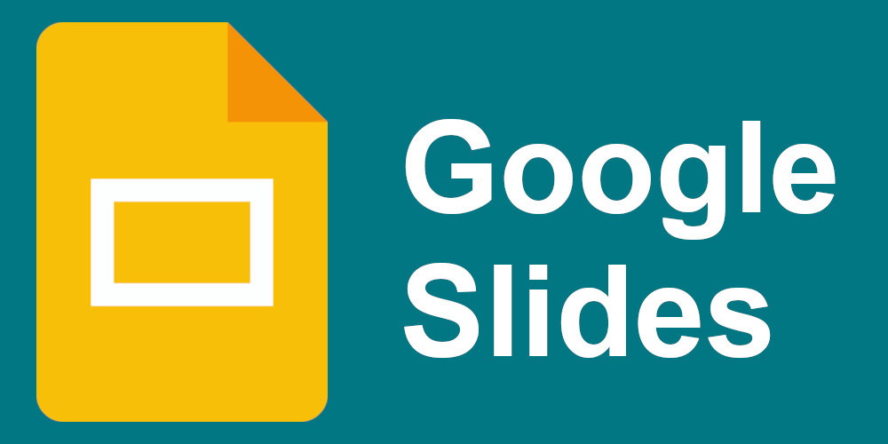
The Fix
One Editor
Automatic Outputs
Easy Sharing
Create
Convert
Publish
Slides Editor
PDF / Images
Attach and Send Email
Blog Post
Blog Website
Documentation Article
Documentation Wiki
Video File (.mp4)
Video Platform
Audio File (.mp3)
Podcast Platform
Online Presentation
Slide Sharing Website
Practical AI Assistance
Multimodal Web Page
Multimodal Website
Text-to-Speech with Michelle - a Male Voice
Notes:
Let’s see how Multimodal Slides can make this easier.
Multimodal Slides is based on using slide editing tools that you are already using, like PowerPoint. {CLICK}To make some creation tasks faster, Multimodal Slides uses some practical A.I. assistance, if needed. {CLICK}Next, Multimodal Slides can generate multimodal content that can then{CLICK} be published to a website.

Slide 8
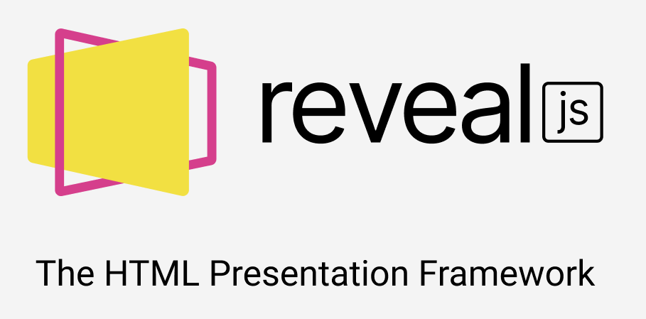

A Solution
One Editor
Automatic Outputs
Easy Sharing
Create
Convert
Publish
?
?
?
Practical AI Assistance
Multimodal Web Page
Multimodal Website
Convert Slide “Notes” to Narration Audio Clips by using
Text-To-Speech APIs
Slides as SVG images.
Narrations as .mp3 files.
Create HTML using the reveal.js standard.
Copy all content to User’s GitHub repository.
User can use GitHub Pages to Host site for free.
User owns and controls all converted content.
Text-to-Speech with Nancy - a Female Voice
Notes:
For example, {CLICK}Multimodal Slides can use Text-to-Speech to convert your slide notes to a narration audio clip. PowerPoint has a built-in feature for you to manually record your presentation to where the audio clip is saved per slide. By itself, it is an awesome feature. However, if you want to simply type what you would say, then Multimodal Slides can handle the Text-to-Speech conversion along with the timestamps of your animations.
{CLICK}Multimodal Slides will convert your slides to SVG images, export narration audio clips as .mp3 files, and create HTML using the reveal.js standard. Reveal.js is a free and open source HTML presentation framework.
{CLICK}Once everything is converted, Multimodal Slides copy all converted content to your GitHub repository, you can then use GitHub Pages to Host a site for free. Since this is your GitHub repository, you own and control all converted content.

Slide 9
Email me at John@MultimodalSlides.com to be a Beta User
I’m Looking for…
(Limited Availability)
PowerPoint Beginners and Power Users
Speakers
Trainers and Teachers
Documentarians
Bloggers
Help me shape what is important to you
Email Me
*** Get Notified When Released ***
(my voice – manually recorded using the Narration feature in PowerPoint)
Notes:
If interested, email me at John@MultimodalSlides.com to become a Beta User.
{CLICK}Overall, I’m looking for PowerPoint users, speakers, trainers, teachers, documentarians, and bloggers. Availability is limited.
{CLICK}Help me shape Multimodal Slides to provide what is important to you.
{CLICK}Also, by emailing me, you will be added to my email list, to get updates on progress and releases.
{CLICK}Feel free to take a pause, and email me now.

Slide 10
Not many options for Slide-based Tools
Too Limited (Slide Sharing)
Slideshare.net
Speaker Deck
DeckLinks
Too Much (LMS Platforms)
iSpring Solutions
Articulate Storyline
Adobe Captivate
Too Different (PowerPoint Alternatives)
Canva
Prezi
Pitch
Text-to-Speech with Davis - a Male Voice
Notes:
There are not many good options for sharing and publishing from slide-based tools, like PowerPoint
{CLICK}The slide sharing sites like Slideshare.net, Speaker Deck and Deck Links are too limited. Many show a lot of ads, do a poor job of converting the slides to images, and provide a weak user interface.
{CLICK}A Learning Management System (LMS) might be too much, meaning too expensive or too complicated. iSpring Solutions integrates into PowerPoint, but the converted content is just ok. Articulate Storyline and Adobe Captivate are popular in the Instructional Design space but might be more than what you need.
{CLICK}Canva has become a lot more popular as a PowerPoint alternative. Prezi and Pitch have also come a long way. However, when it comes to using those alternatives, they might be a little too different than what you might be used to in PowerPoint. All three alternatives usually do a poor job importing a PowerPoint file.

Slide 11
This Website (MultimodalSlides.com)
Created in PowerPoint
Used tools for Text-to-Speech and Convert to Multimodal Web Page
Hosted on GitHub Pages
Text-to-Speech with Steffan - a Male Voice
Notes:
The MultimodalSlides.com website was created using the Multimodal Slides platform.
{CLICK}All of the content created for MultimodalSlides.com was done in PowerPoint.
{CLICK}The Multimodal Slides platform used Text-to-Speech for some slides and converted to a web page.
{CLICK}The MultimodalSlides.com website is hosted on GitHub Pages for free.

Slide 12
Nothing else out there provides this Multimodal Experience!
Just use PowerPoint with NO Add-ins
Best converted Slides to SVG images
You own and store your data!
Text-to-Speech with Ana - a Female Voice
Notes:
There is nothing else out there that provides this Multimodal Experience!
{CLICK}For Multimodal Slides, you just need to use PowerPoint and there are no add-ins to install.
{CLICK}Multimodal Slides provides the best conversion of slides to SVG images.
{CLICK}Most importantly, Multimodal Slides does not own or store your data!

Slide 13

Roadmap
Clone your voice as a Text-to-Speech option
Integration with your Site
Better Formatting in Notes / Text / Transcript
More Viewing Options (Modes)
Presentation Mode
Reading Mode
Video Player Mode
Article Title
Article Title
Current Slide
Notes
Slide
Video /
Current Slide
Notes
Slide
Notes
Slide
Notes
Slide
Notes
Notes
Slide
…
…
Text-to-Speech with Sara - a Female Voice
Notes:
Here are some of the features on the roadmap.
{CLICK}The ability to clone your voice as a text-to-speech option is currently a popular item.
{CLICK}Providing better formatting capabilities in your Notes, also thought of as the text or transcript of the content. The use of Markdown is a popular request.
{CLICK}The primary goal is to provide more viewing options, otherwise known as modes.
{CLICK}The Presentation Mode is the current available experience. It is a similar experience on how you can share an embedded PowerPoint or Google Slides presentation without the player capability.
{CLICK}The Reading Mode has more of a Blog Post look and feel. It is a nice alternative for someone that want to quickly scroll through the content.
{CLICK}The Video Player Mode is a combination of the Presentation Mode and the Reading Mode. As the presentation plays, the notes and slide thumbnails scroll with the player.
{CLICK}Also, providing an integration with your web site seems like a useful feature. Overall, we need to hear from you on what you find important.

Slide 14


Choose your modality
Download
Slides with Notes (Transcript)
Watch on
Video Exported from PowerPoint
Source File
Download and Run the Slide Show with Narrations
John@MultimodalSlides.com
Source Repository on GitHub
See how the code and data is structured
(my voice – manually recorded using the Narration feature in PowerPoint)
Notes:
You can choose your modality, through these traditional sources.
{CLICK}This content can be downloaded as a PDF {CLICK}or watched on YouTube.
{CLICK}You can download the source PowerPoint file to run the slide show with the narrations.
{CLICK}Also, you can go to GitHub to see how the code and data behind the website is structured.
{CLICK}Email me at John@MultimodalSlides.com to become a Beta User and to get on the email list.

